Slide 1
Introduction to DBMS

Slide 2
Unit I
Introduction : Basic concepts.
Advantages of DBMS over file processing systems.
Data abstraction.
Database languages.
Data models.
Data independence.
Components of a DBMS.
Overall structure of DBMS.
Multi-user DBMS architecture.
System catalogs.
Data Modeling: Basic concepts, Entity, attributes, relationships, constraints, keys. 12.Case Study: MySQL Database
Jayashree Jagdale, PICT, Pune
2

Slide 3
Introduction : Basic concepts
Database:
A collection of related data.
Data:
Known facts that can be recorded and have an implicit meaning.
Mini-world:
Some part of the real world about which data is stored in a database. For example, student grades
and transcripts at a university.
Database Management System (DBMS):
A software package/ system to facilitate the creation and maintenance of a computerized database.
Database System:
The DBMS software together with the data itself. Sometimes, the applications are also included.
Jayashree Jagdale, PICT, Pune
3
Book: Database concepts by Korth, Sudarshan

Slide 4
Database Management System (DBMS)
DBMS contains information about a particular enterprise
Collection of interrelated data
Set of programs to access the data
An environment that is both convenient and efficient to use Database Applications:
Banking: all transactions Airlines: reservations, schedules Universities: registration, grades
Sales: customers, products, purchases
Online retailers: order tracking, customized recommendations Manufacturing: production, inventory, orders, supply chain Human resources: employee records, salaries, tax deductions
Databases touch all aspects of our lives
Book: Database concepts by Korth, Sudarshan

Slide 5
Drawbacks of using file systems to store data
Data redundancy and inconsistency
Multiple file formats, duplication of information in different files
Difficulty in accessing data
Need to write a new program to carry out each new task
Data isolation
Multiple files and formats
Integrity problems
Integrity constraints (e.g., account balance > 0) become “buried” in program code rather than being stated explicitly
Hard to add new constraints or change existing ones
Jayashree Jagdale, PICT, Pune
<number>
Book: Database concepts by Korth, Sudarshan

Slide 6
Drawbacks of using file systems to store data
cont
Atomicity of updates
Failures may leave database in an inconsistent state with partial updates carried out
Example: Transfer of funds from one account to another should either complete or
not happen at all
Concurrent access by multiple users
Concurrent access needed for performance
Uncontrolled concurrent accesses can lead to inconsistencies
Example: Two people reading a balance (say 100) and updating it by withdrawing money (say 50 each) at the same time
Security problems
Hard to provide user access to some, but not all, data
Database systems offer solutions to all the above problems
Jayashree Jagdale, PICT, Pune
<number>
Book: Database concepts by Korth, Sudarshan

Slide 7
Advantages of DBMS over file processing systems
Controlling redundancy in data storage and in development and maintenance efforts.
Sharing of data among multiple users.
Restricting unauthorized access to data.
Providing persistent storage for program Objects
In Object-oriented DBMSs
Providing Storage Structures (e.g. indexes) for efficient Query Processing
Providing backup and recovery services.
Providing multiple interfaces to different classes of users.
Representing complex relationships among data.
Enforcing integrity constraints on the database.
Drawing inferences and actions from the stored data using deductive and active rules
Jayashree Jagdale, PICT, Pune
<number>
Book: Database concepts by Korth, Sudarshan

Slide 8

Abstraction

Slide 9
Data abstraction
Physical level: The lowest level of abstraction describes how the data are actually
stored. The physical level describes complex low-level data structures in detail and describes how a record is stored. E.g Employee record
Logical level: Describes data stored in database, and the relationships among the data.
type instructor = record
ID : string;
name : string; dept_name : string; salary : integer;
end;
Physical data independence:
View level: Application programs hide details of data types. Views can also hide information (such as an employee’s salary) for security purposes.
Jayashree Jagdale, PICT, Pune
9
Book: Database concepts by Korth, Sudarshan

Slide 10
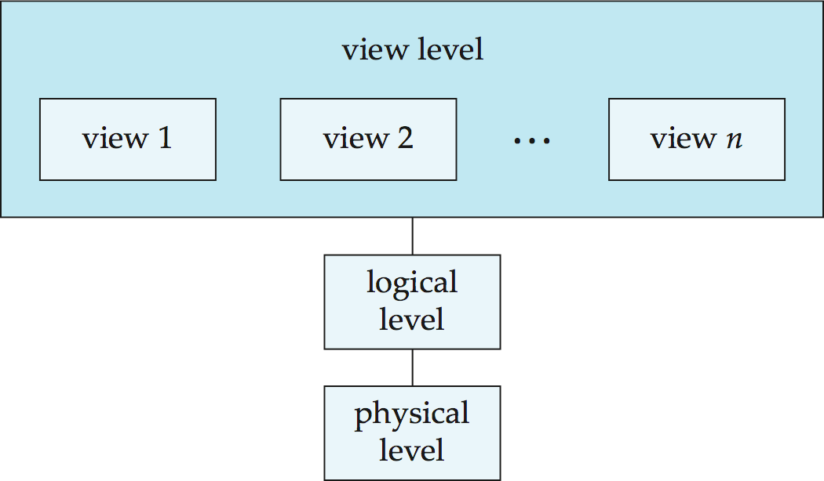
The three levels of data abstraction
Sequential or random access and file organisation methods like B+ trees, hashing, Blocks of storage and the amount of memory used for storing a particular record.
Book: Database concepts by Korth, Sudarshan

Slide 11
The three levels of data abstraction
Abstraction
Characteristic that allows to modify the physical schema without any
alterations to the conceptual or logical schema.
Conceptual structure of the database would not be affected by any change in storage size of the database system server.
E.g., Changing from sequential to random access file.
These alterations or modifications to the physical structure may include:
Utilizing new storage devices.
Modifying data structures used for storage.
Altering indexes or using alternative file organisation techniques etc.
Book: Database concepts by Korth, Sudarshan

Slide 12
The three levels of data abstraction
Information that is actually stored in the database in the form of tables.
It also stores the relationship among the data entities in relatively simple structures. E.g., Attributes of an employee and relationships with manager.
Book: Database concepts by Korth, Sudarshan

Slide 13
Students
Rollno
Department Rollno
The three levels of data abstraction
Students
Teachers
Characteristic of being able to modify the logical schema without affecting the external schema or application program.
The user view of the data would not be affected by any changes to the conceptual
view of the data.
E.g., Insertion or deletion of attributes, altering table structures entities or relationships to the logical schema etc.
Book: Database concepts by Korth, Sudarshan

Slide 14
The three levels of data abstraction
Highest level of abstraction.
Part of the actual database is viewed by the users. Ease the accessibility of the database by an individual user.
Tables and relations are used to store data. Multiple views of the same database may exist. Users can just view the data and interact with the database.
Storage and implementation details are hidden from them.
Book: Database concepts by Korth, Sudarshan

Slide 15
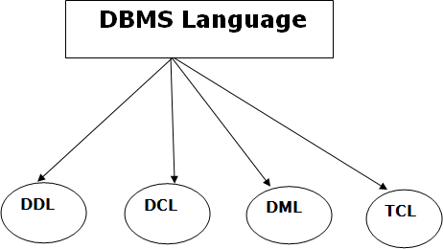
Database languages
A DBMS has appropriate languages and interfaces to express database queries and updates.
Database languages can be used to read, store and update the data in the database.
Jayashree Jagdale, PICT, Pune
1
https://www.javatpoint.com/dbms-language

Slide 16
Database languages
Data Definition Language
DDL stands for Data Definition Language. It is used to define database structure or pattern.
It is used to create schema, tables, indexes, constraints, etc. in the database.
Using the DDL statements, you can create the skeleton of the database.
Data definition language is used to store the information of metadata like the number of tables and schemas, their names, indexes, columns in each table, constraints, etc.
Jayashree Jagdale, PICT, Pune
1
https://www.javatpoint.com/dbms-language

Slide 17
Database languages
Create: It is used to create objects in the database.
Alter: It is used to alter the structure of the database.
Drop: It is used to delete objects from the database.
Rename: It is used to rename an object.
Comment: It is used to comment on the data dictionary.
These commands are used to update the database schema that's why they come under Data definition language.
Jayashree Jagdale, PICT, Pune
1
https://www.javatpoint.com/dbms-language

Slide 18
Database languages
Data-Definition Language
Specification notation for defining the database schema Example: create table instructor (
ID
name
char(5), varchar(20),
dept_name varchar(20),
salary numeric(8,2))
DDL compiler generates a set of table templates stored in a data dictionary
Data dictionary contains metadata (i.e., data about data)
Database schema
Integrity constraints
Primary key (ID uniquely identifies instructors)
Authorization
Who can access what
Jayashree Jagdale, PICT, Pune
1
Book: Database concepts by Korth, Sudarshan

Slide 19
Database languages
Data manipulation Language
DML stands for Data Manipulation Language. It is used for accessing and manipulating data in a database. It handles user re
Select: It is used to retrieve data from a database.
Insert: It is used to insert data into a table.
Update: It is used to update existing data within a table.
Delete: It is used to delete all records from a table.
Merge: It performs UPSERT operation, i.e., insert or update operations.
Call: It is used to call a structured query language or a Java subprogram.
Explain Plan: It has the parameter of explaining data.
Lock Table: It controls concurrency.
Jayashree Jagdale, PICT, Pune
1
https://www.javatpoint.com/dbms-language

Slide 20
Database languages
Data manipulation Language
select * from Employee;
insert into Employee (10, “xyz”, “Associate engineer”, “IT”);
Jayashree Jagdale, PICT, Pune
1
https://www.javatpoint.com/dbms-language

Slide 21
Database languages
Data Control Language
DCL stands for Data Control Language. It is used to retrieve the stored or saved data.
The DCL execution is transactional. It also has rollback parameters.
(But in Oracle database, the execution of data control language does not have the feature of rolling back.)
Here are some tasks that come under DCL:
Grant: It is used to give user access privileges to a database.
Revoke: It is used to take back permissions from the user.
There are the following operations which have the authorization of Revoke:
CONNECT, INSERT, USAGE, EXECUTE, DELETE, UPDATE and SELECT.
Jayashree Jagdale, PICT, Pune
1
https://www.javatpoint.com/dbms-language

Slide 22
Database languages
Transaction Control Language
TCL is used to run the changes made by the DML statement. TCL can be grouped into a logical transaction.
Here are some tasks that come under TCL:
Commit: It is used to save the transaction on the database.
Rollback: It is used to restore the database to original since the last Commit.
Jayashree Jagdale, PICT, Pune
1
https://www.javatpoint.com/dbms-language

Slide 23
Unit I
Introduction : Basic concepts.
Advantages of DBMS over file processing systems.
Data abstraction.
Database languages.
Data models.
Data independence.
Components of a DBMS.
Overall structure of DBMS.
Multi-user DBMS architecture.
System catalogs.
Data Modeling: Basic concepts, Entity, attributes, relationships, constraints, keys. 12.Case Study: MySQL Database
Jayashree Jagdale, PICT, Pune
1

Slide 24
Data models
Relational model
Entity-relationship model
Object-Based database model
Document model
Star schema
Hierarchical database model
Network model
The object-relational model, which combines the two that make up its name
Jayashree Jagdale, PICT, Pune
1
https://www.lucidchart.com/pages/database-diagram/database-models#section_0

Slide 25

Data models: Relational Model.
Jayashree Jagdale, PICT, Pune
1
https://www.lucidchart.com/pages/database-diagram/database-models#section_0

Slide 26
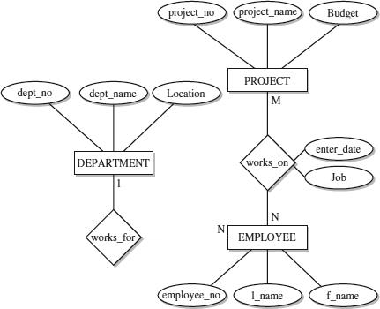
Data models: Entity-Relational Model.
Jayashree Jagdale, PICT, Pune
1
https://logicalread.com/sql-server-entity-relationship-model-mc03/#.YBfe4Ogza00

Slide 27
Data models: Object-Based Data Model.
Collection of objects, or reusable software elements, with associated features and methods.
Types of object-oriented databases:
A multimedia database incorporates media, such as images, that could not be stored in a relational database.
A hypertext database allows any object to link to any other object. It’s useful for organizing lots of disparate data, but it’s not ideal for numerical analysis.
The object-oriented database model is the best known post-relational database model, since it incorporates tables, but isn’t limited to tables. Such models are also known as hybrid database models.
Languages and call interfaces include SQL3, vendor languages, ODBC, JDBC, and proprietary call interfaces that are extensions of the languages and interfaces used by the relational model.
Jayashree Jagdale, PICT, Pune
1
https://www.lucidchart.com/pages/database-diagram/database-models#section_0

Slide 28
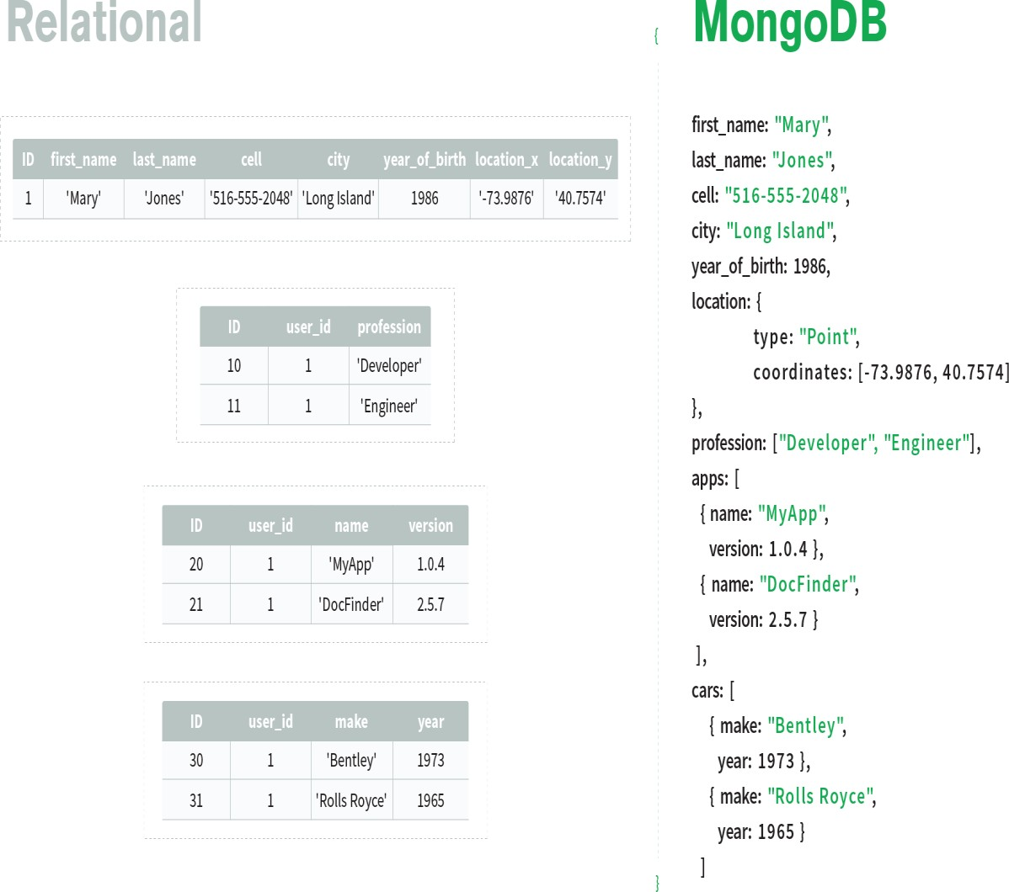
Data models: Document model.
A document database is a type of nonrelational database that is designed to store and query data as JSON-like documents.
Sometimes called NoSQL database, the document data model has become the most popular alternative to tabular, relational databases.
Easier for developers to store and query data in a database by using the same document-model format they use in their application code.
The flexible, semi structured, and hierarchical nature of documents and document databases allows them to evolve with applications’ needs.
Jayashree Jagdale, PICT, Pune
1
https://www.mongodb.com/document-databases

Slide 29
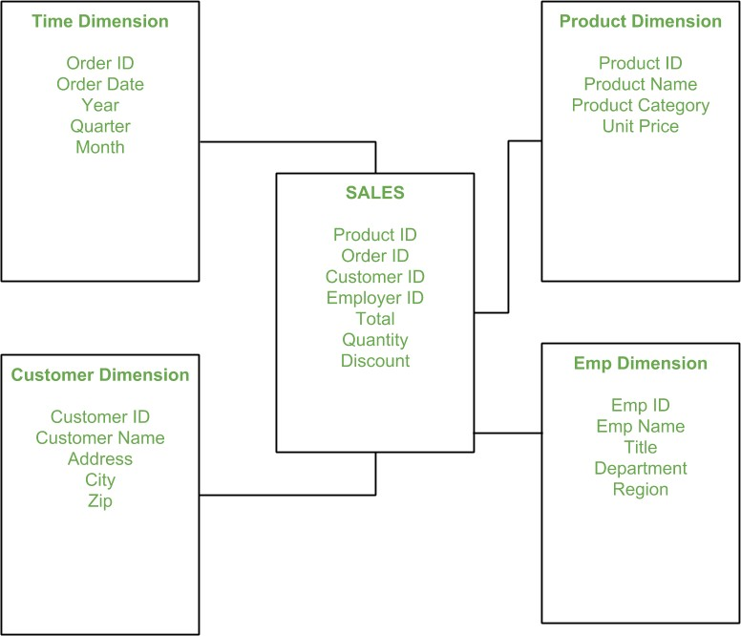
Data models: Star schema.
Star schema is the fundamental schema among the data mart schema and it is simplest. This schema is widely used to develop or build a data warehouse and dimensional data marts.
Jayashree Jagdale, PICT, Pune
1
https://www.geeksforgeeks.org/star-schema-in-data-warehouse-modeling/

Slide 30
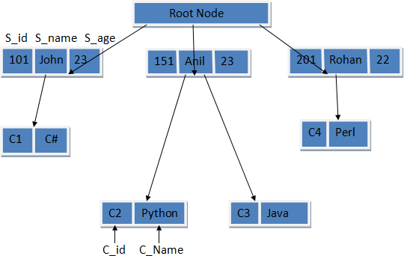
Data models: Hierarchical database model.
A hierarchical model represents the data in a tree-like structure in which there is a single parent for each record. To maintain order there is a sort field which keeps sibling nodes into a recorded manner. These types of models are designed basically for the early mainframe database management systems, like the Information Management System (IMS) by IBM.
https://www.educba.com/hierarchical-database-model/
https://www.tutorialspoint.com/Hierarchical-Database-Model
Jayashree Jagdale, PICT, Pune
30

Slide 31
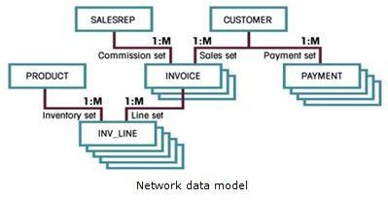
Data models: Network model.
The network database model was created to solve the shortcomings of the hierarchical database model. In this type of model, a child can be linked to multiple parents, a feature that was not supported by the hierarchical data model. The parent nodes are known as owners and the child nodes are called members.
https://www.tutorialspoint.com/Network-Data-Model
Jayashree Jagdale, PICT, Pune
31
http://www.myreadingroom.co.in/notes-and-studymaterial/65-dbms/469-network-data-model.html

Slide 32
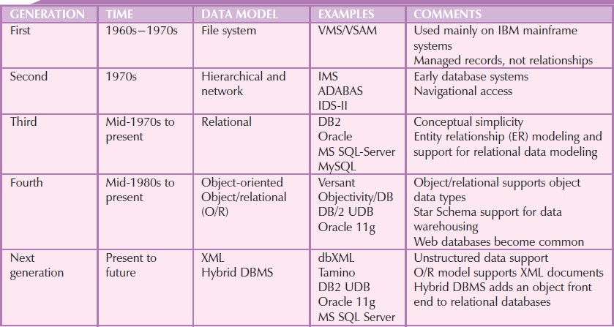
Evolution of data models
Database system- design, implementation & Management, by Rob and Coronel, Thomson
Jayashree Jagdale, PICT, Pune
<number>

Slide 33
The Future of Data Models
Today the O/R DBMS is the dominant database for business applications due to model’s conceptual simplicity, easy-to-use query language, high transaction performance, high availability, security, scalability, and expandability.
The OO DBMS is popular in niche markets such as computer-aided drawing/computer aided manufacturing (CAD/CAM), geographic information systems (GIS), telecommunications, and multimedia, which require support for complex objects.
Hybrid DBMSs are emerging with advantages of the relational model and provide programmers with an object-oriented view of the underlying data. They preserve the performance characteristics of the relational model and the semantically rich programmatic support of the object-oriented model.
SQL data services, such as Microsoft SQL Data Services (SDS) on its Azure Services Platform, are becoming a critical component of relational database vendors’ Internet service strategies. These “cloud- based” (that is, remotely processed and Internet-based) data services make it possible for companies of any size to store their data in relational databases without incurring expensive hardware, software, and personnel costs, while having access to high-end database features such as failover, backup, high transaction rates, and global data distribution. Companies can use a “pay as you go” system based primarily on their storage and bandwidth utilization and the features used.
Database system- design, implementation & Management, by Rob and Coronel, Thomson
Jayashree Jagdale, PICT, Pune
<number>

Slide 34
Homework
1. Study Advantages and disadvantages of each model.
Reference: Book by Rob & Coronel, Database system- design, implementation & Management, Thomson publications.

Slide 35
Data independence
Although implementation of the simple structures at the logical level may involve complex physical-level structures, the user of the logical level does not need to be aware of this complexity. This is referred to as physical data independence. Database administrators, who must decide what information to keep in the database, use the logical level of abstraction.
Of these, the logical schema is by far the most important, in terms of its effect on application programs, since programmers construct applications by using the logical schema. The physical schema is hidden beneath the logical schema and can usually be changed easily without affecting application programs.
Application programs are said to exhibit physical data independence if they do not depend on the physical schema, and thus need not be rewritten if the physical schema changes.
Jayashree Jagdale, PICT, Pune
35

Slide 36
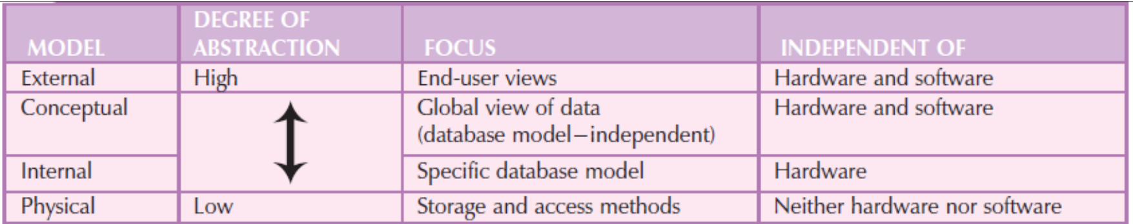
Data independence
Jayashree Jagdale, PICT, Pune
36
Database system- design, implementation & Management, by Rob and Coronel, Thomson

Slide 37
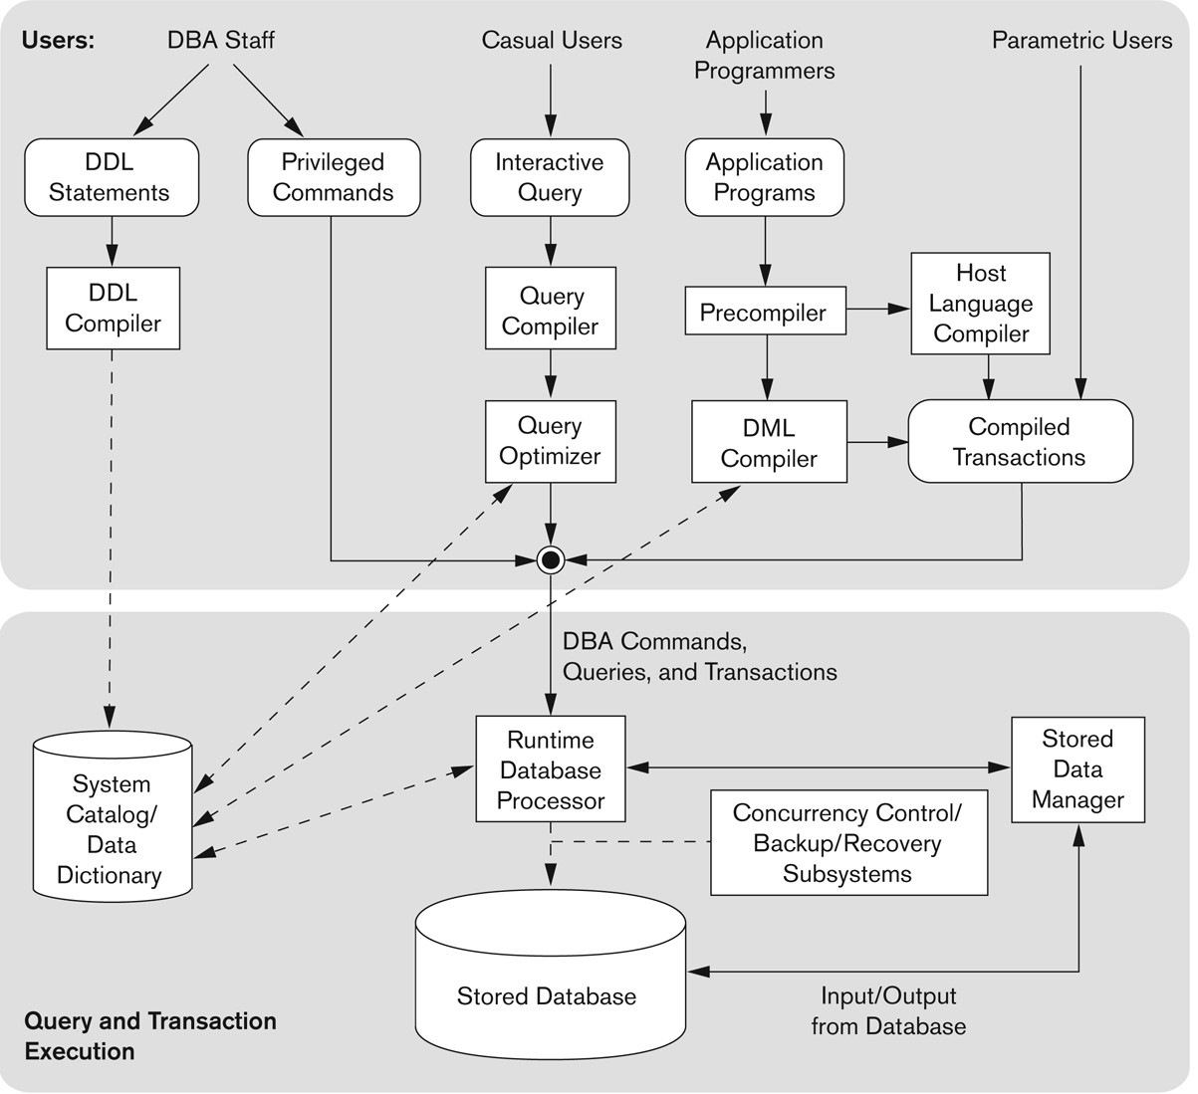
Components of a DBMS
Jayashree Jagdale, PICT, Pune
37

Slide 38
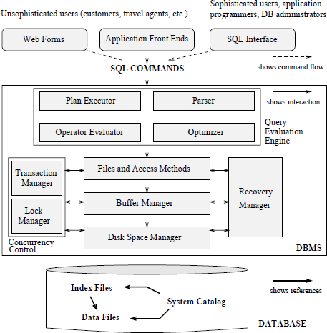
Overall structure of DBMS
Web form Name : Roll_no:
Address: | Qu | ery: Insert into student values (Pranjali, 23102, xyz)
Jayashree Jagdale, PICT, Pune 38
Database management system by Raghu Ramkrishnan, Johannes Gehrke

Slide 39
Overall structure of DBMS
Roll_no:
Search
Select from student name, addr where rollno= x;
Name : Address:
Parser - Select from student name, addr where rollno= x;
Optimizer - Select from student name, addr where rollno= x and rollno = x;
Jayashree Jagdale, PICT, Pune 39
Database management system by Raghu Ramkrishnan, Johannes Gehrke

Slide 40
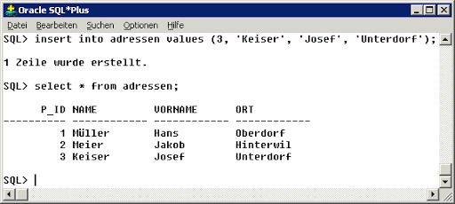
Overall structure of DBMS
Jayashree Jagdale, PICT, Pune 40
Database management system by Raghu Ramkrishnan, Johannes Gehrke

Slide 41
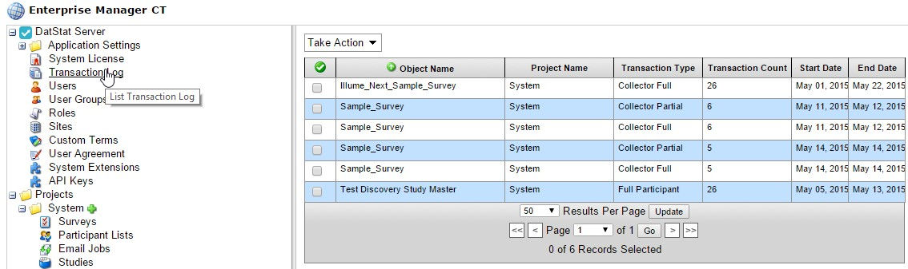
Overall structure of DBMS
Jayashree Jagdale, PICT, Pune 41
Database management system by Raghu Ramkrishnan, Johannes Gehrke

Slide 42
Overall structure of DBMS
1. Query Processor/ Query evaluation engine :
It interprets the requests (queries) received from end user via an application program into
instructions. It also executes the user request which is received from the DML compiler. Query Processor contains the following components –
DML Compiler –
It processes the DML statements into low level instruction (machine language), so that they can be
executed.
DDL Interpreter –
It processes the DDL statements into a set of table containing meta data (data about data).
Embedded DML Pre-compiler –
It processes DML statements embedded in an application program into procedural calls.
Query Optimizer –
It executes the instruction generated by DML Compiler
Jayashree Jagdale, PICT, Pune
1

Slide 43
Overall structure of DBMS
2. Storage Manager :
Storage Manager is a program that provides an interface between the data stored in the database and the queries received. It is also known as Database Control System. It maintains the consistency and integrity of the database by applying the constraints and executes the DCL statements. It is responsible for updating, storing, deleting, and retrieving data in the database.
It contains the following components – Authorization Manager –
It ensures role-based access control, i.e,. checks whether the particular person is privileged to perform
the requested operation or not.
Integrity Manager –
It checks the integrity constraints when the database is modified.
Transaction Manager –
It controls concurrent access by performing the operations in a scheduled way that it receives the transaction. Thus, it ensures that the database remains in the consistent state before and after the execution of a transaction.
Jayashree Jagdale, PICT, Pune
1

Slide 44
Overall structure of DBMS
2. Storage Manager :
File Manager
It manages the file space and the data structure used to represent information in the database.
Buffer Manager –
It is responsible for cache memory and the transfer of data between the
secondary storage and main memory
Jayashree Jagdale, PICT, Pune
1

Slide 45
Overall structure of DBMS
3. Disk Storage :
It contains the following components –
Data Files –
It stores the data.
Data Dictionary –
It contains the information about the structure of any database object. It is the repository of information that governs the metadata.
Indices –
It provides faster retrieval of data item.
Jayashree Jagdale, PICT, Pune
1

Slide 46
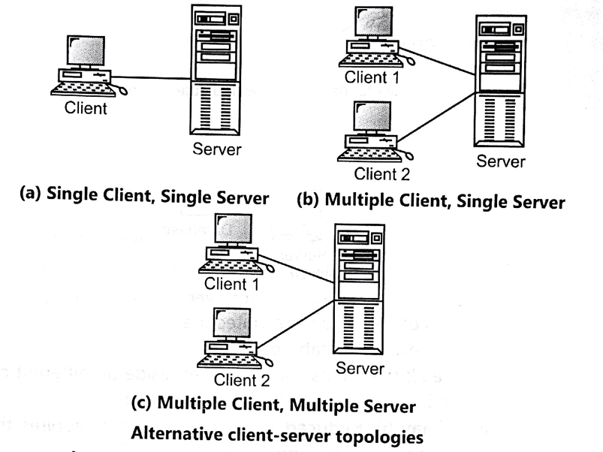
Multi-user DBMS architecture
Jayashree Jagdale, PICT, Pune
1

Slide 47
System catalogs or Data dictionary
The system catalogue is a collection of tables and views that contain important information about a database.
It is the place where a relational database management system stores schema metadata, such as information about tables and
columns, and internal bookkeeping information
For example, the data dictionary language for all tables in the database is stored in the system catalogue. The system catalogue for a database is actually part of the database .
The system catalogue is basically a group of objects that contain information that defines other objects in the database, the structure of the database itself, and various other significant information.
The information stored in a catalogue of an RDBMS includes:
the relation names,
attribute names,
attribute domains (data types),
descriptions of constraints (primary keys, secondary keys, foreign keys, NULL/ NOT NULL, and other types of constraints),
views, and
storage structures and indexes (index name, attributes on which index is defined, type of index etc).
Jayashree Jagdale, PICT, Pune
1

Slide 48
System catalogs or Data dictionary
Security and authorisation information is also kept in the catalogue, which describes:
authorised user names and passwords,
each user’s privilege to access specific database relations and views,
the creator and owner of each relation. The privileges are granted using GRANT command. A listing of such commands is given in Figure 1.
The system catalogue can also be used to store some statistical and descriptive information about relations. Some such information can be:
number of tuples in each relation,
the different attribute values,
storage and access methods used in relation.
Jayashree Jagdale, PICT, Pune
1

Slide 49
System catalogs or Data dictionary
Relation_Name | Attribute | Attr_Type | Primary_Key | Forgn_Key | Forgn_Key_REL
Student | RollNo | INTEGER(10) | Yes | No
Student | Name | VARCHAR2(30) | No | No
Student | Address | VARCHAR2(50) | No | No
Student | PhoneNo | VARCHAR2(10) | No | No
Student | DOB | Date/Time | No | No
Student | email | VARCHAR2(30) | No | No
Student | CourseNo | INTEGER(10) | No | Yes | Course
Student | Dno | INTEGER(10) | No | Yes | Dept
Course | CourseNo | INTEGER(10) | Yes | No
Course | CourseTitle | VARCHAR2(10) | No | No
Jayashree Jagdale, PICT, Pune
1

Slide 50
System catalogs or Data dictionary
The benefits of a fully utilized data dictionary are substantial. A data dictionary has the potential to:
facilitate data sharing by
enabling database classes to automatically handle multi-user coordination, buffer layouts, data validation, and performance optimisations,
improving the ease of understanding of data definitions,
ensuring that there is a single authoritative source of reference for all users
facilitate application integration by identifying data redundancies, reduce development lead times by
simplifying documentation
automating programming activit^{J}i^{ay}e^{as}s^{h}.^{ree Jagdale, PICT, Pune}
50

Slide 51
System catalogs or Data dictionary
Reduce maintenance effort by identifying the impact of change as it affects: users, data base administrators, programmers.
Improve the quality of application software by enforcing standards in the development process
Ensure application system longevity by maintaining documentation beyond project
completions
Data dictionary information created under one database system can easily be used to generate the same database layout on any of the other database systems BFC supports (Oracle, MS SQL Server, Access, DB2, Sybase, SQL Anywhere, etc.)
These benefits are maximised by a fully utilised data dictionary. As the next section will show, our environment is such that not all of these benefits are immediately available to us.
Jayashree Jagdale, PICT, Pune
1

Slide 52
Data Modeling
Basic concepts
Entity
Attributes
Relationships
Constraints
Keys
Jayashree Jagdale, PICT, Pune
<number>

Slide 53
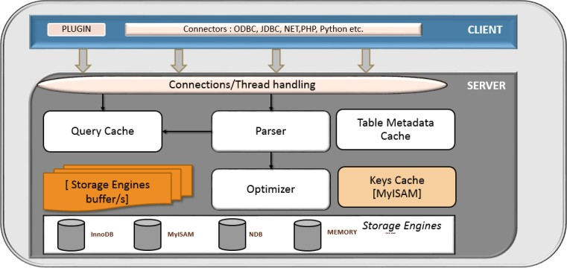
MySQL Case study
MySQL is a freely available open source Relational Database Management System (RDBMS) that uses Structured Query Language (SQL).
Query cache is a prominent MySQL feature that speeds up data retrieval from a database. It achieves this by storing MySQL SELECT statements together with the retrieved record set in memory, then if a client requests identical queries it can serve the data faster without executing commands again from the database

Slide 54
MySQL Case study
Keys Cache MyISAM

Slide 55
MySQL Case study
A storage engine is the underlying software component that a database management system (DBMS) uses to create, read, update and delete (CRUD) data from a database.
(The CREATE TABLE statement in MySQL 8.0 creates InnoDB tables by default.)
Demonstration of database in MySQL.
List of commands : http://g2pc1.bu.edu/~qzpeng/manual/MySQL%20Commands.htm

Slide 56
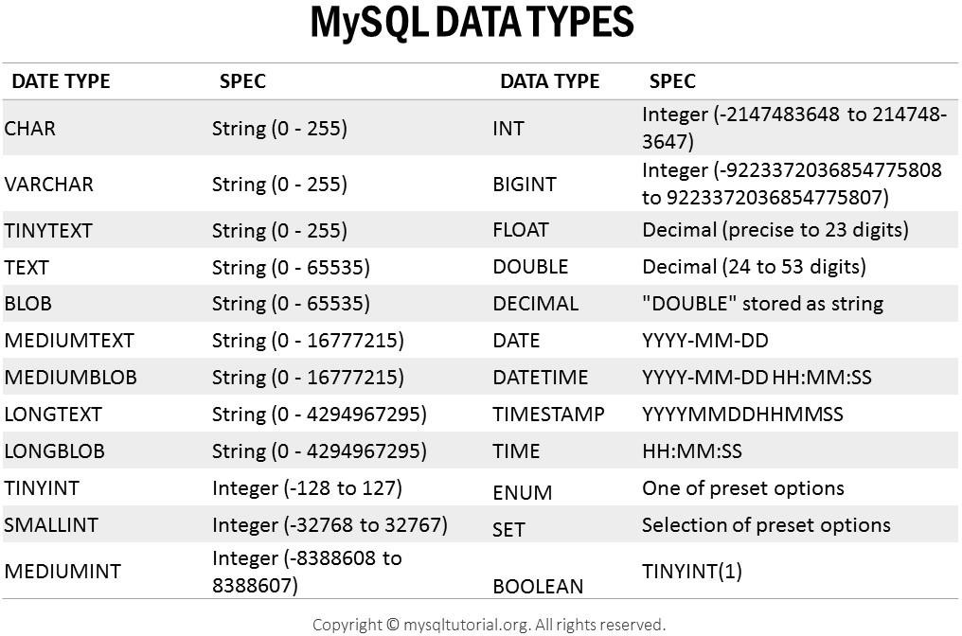

Slide 57
Crossword for Unit - I
https://crosswordlabs.com/view/database-management-system-chapter-1

